Slide 1

Presented at the WPPA 10th Annual Conference
Founded in 2013 by Stewart I Donaldson, Ph.D. founding Dean of the newly formed School of Social Science, Policy, and Evaluation (SSSPE) and the School of Community & Global Health at CGU, Meg Rao CGU graduate student now Meg Warren, Ph.D and Shari Young Kuchenbecker, Ph.D. Professor of Psychology at Chapman University with the goal of creating an inclusive western region association supporting student/faculty research within and between institutions
building the science of positive psychology.
That year, Stewart was Chair of the International Positive Psychology Association (IPPA) Conference held in Los Angeles in 2013.
© Shari Young Kuchenbecker, Ph.D.
May 30, 2026

Slide 2
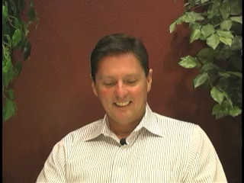
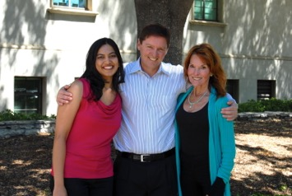
2013
Please click the video forward arrow below President and Co-Founder Stewart I. Donaldson’s photo to hear his original vision founding Western Positive Psychology Association (WPPA).

Slide 3
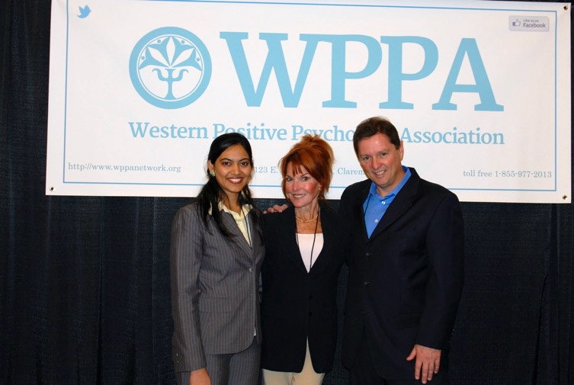
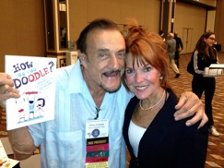
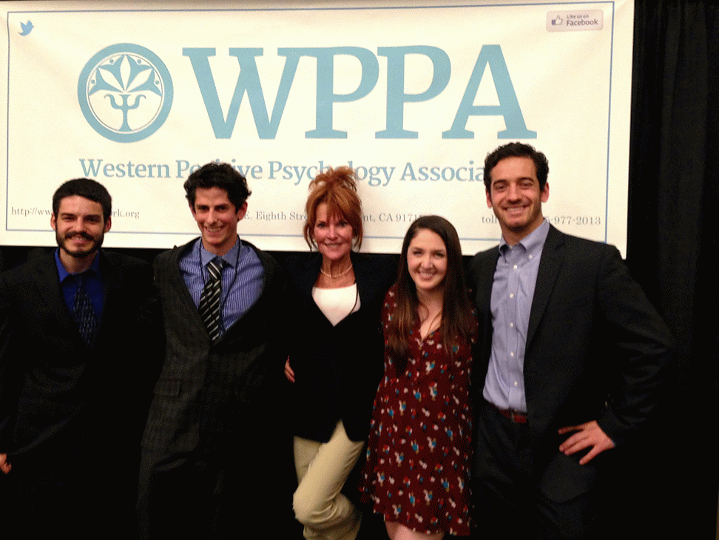
WPPA at WPA 2013

Slide 4
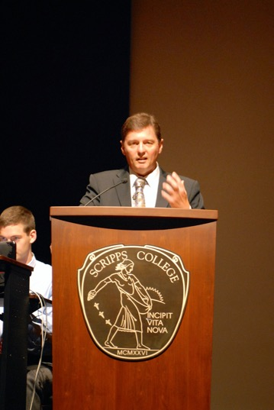
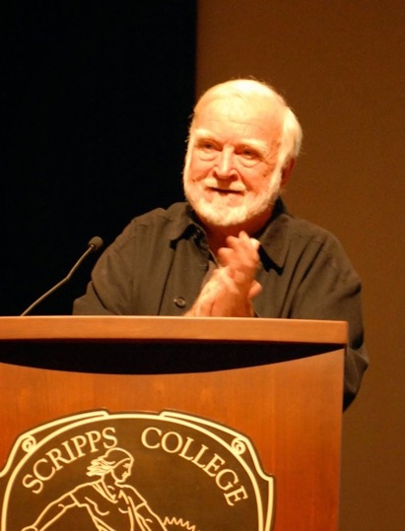
WPPA 1st Conference - CGU 2014 celebrating Csikszentmihalyi’s 80th Birthday

Slide 5
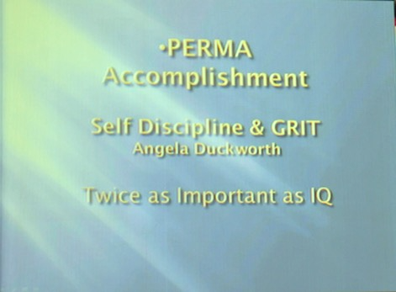
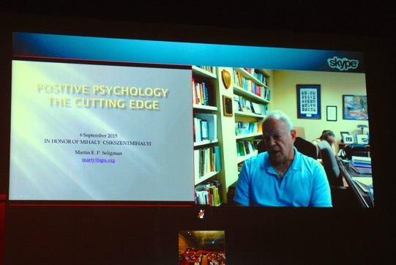
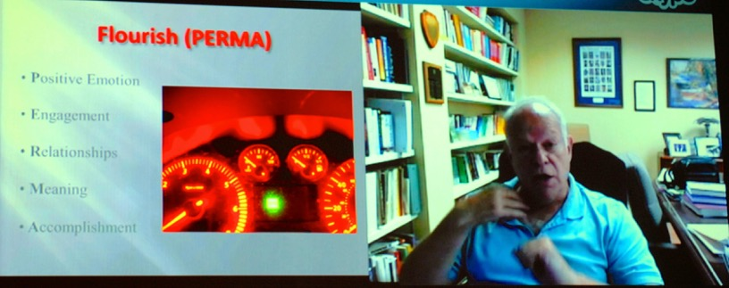

Slide 6
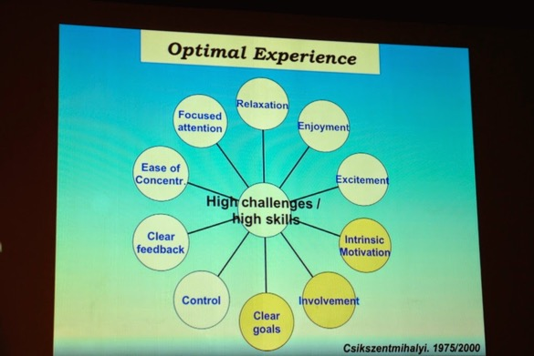
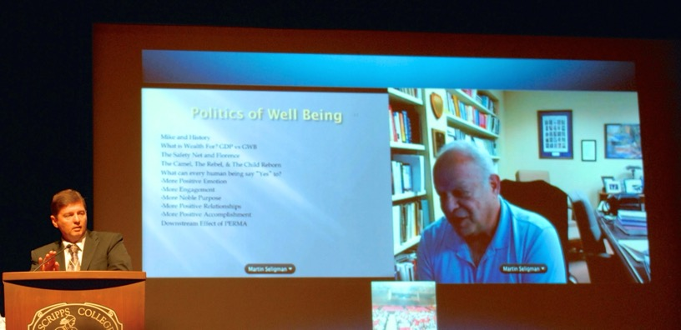

Slide 7
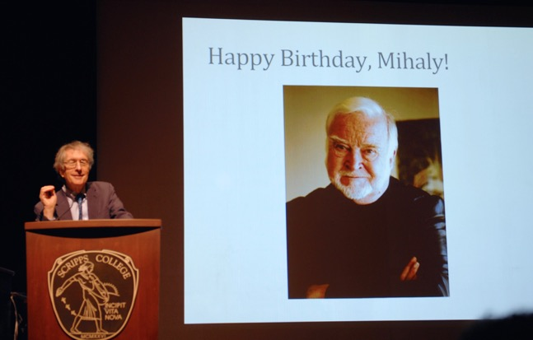
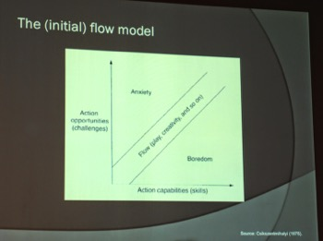
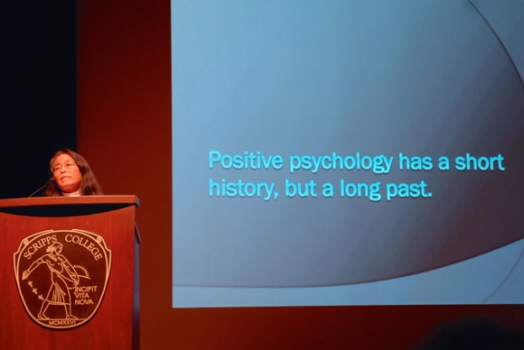

Slide 8
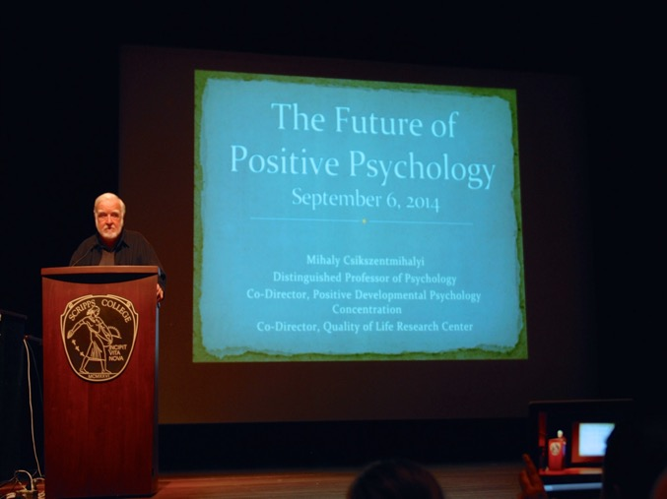
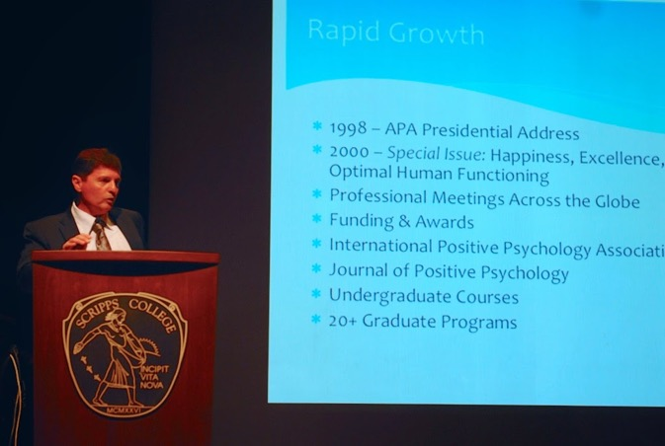

Slide 9
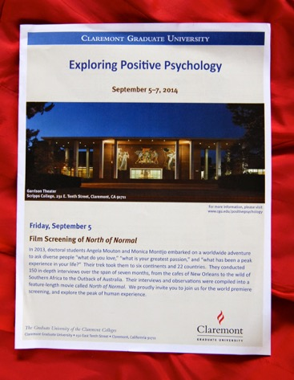
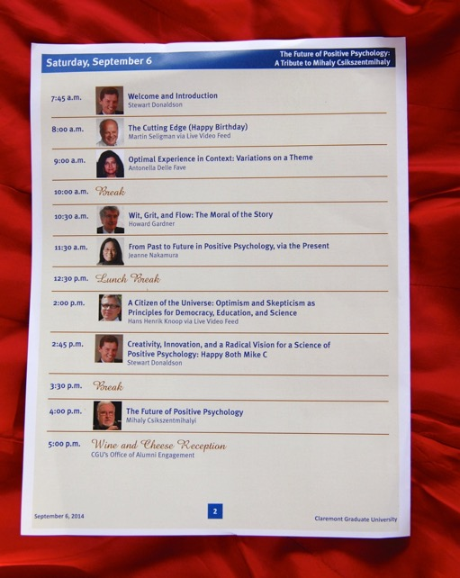
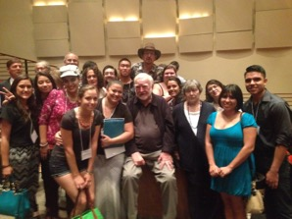
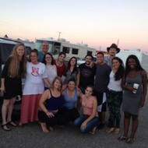
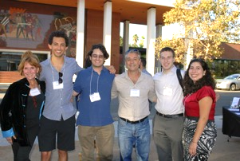
Thank you to all
faculty student attendees.
Professor Bruce Smith & his University of New Mexico team at the heart of our founding community shown here!

Slide 10
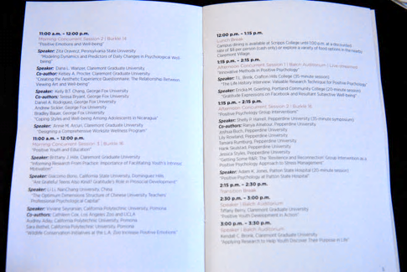
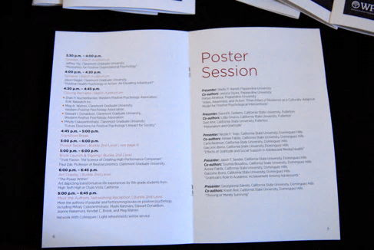
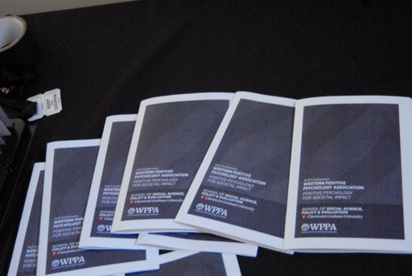
WPPA 2nd Conference – CGU - 2017

Slide 11
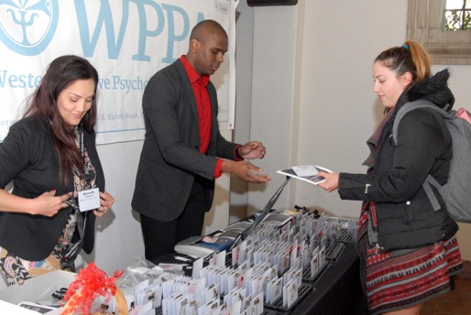
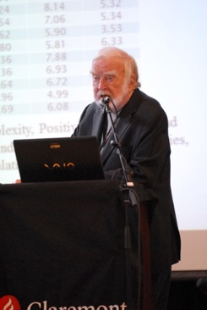
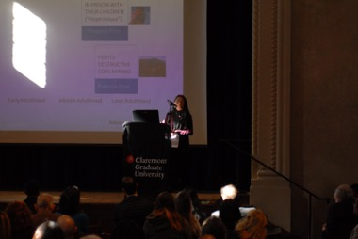
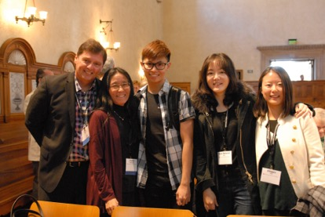
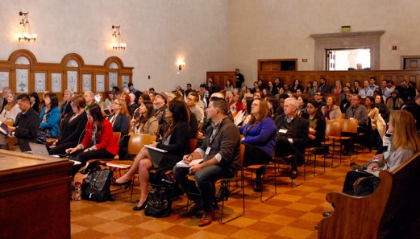

Slide 12
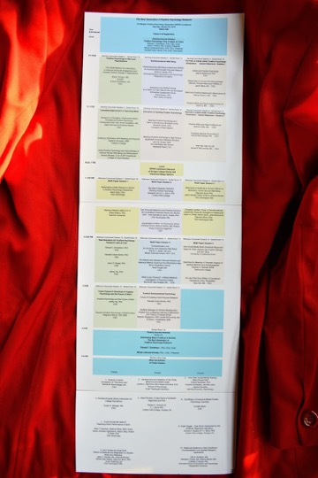
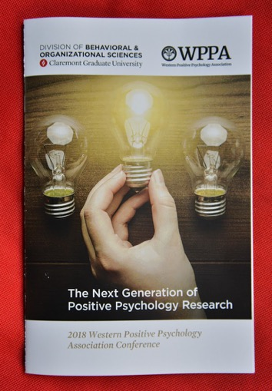
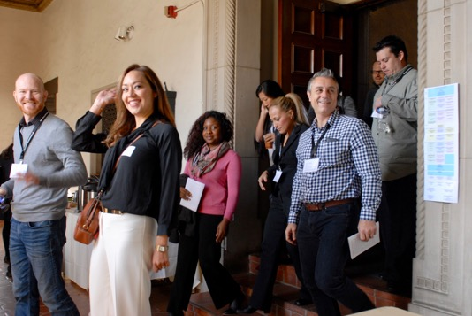
WPPA 3rd Conference - CGU 2018

Slide 13
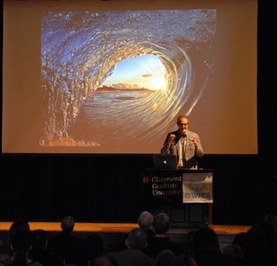
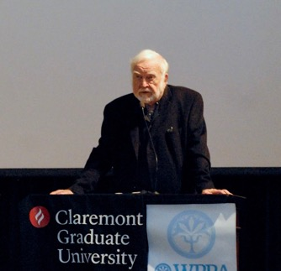
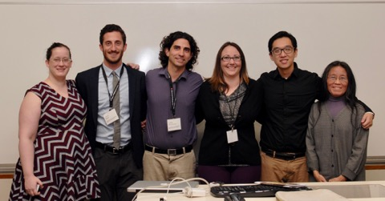
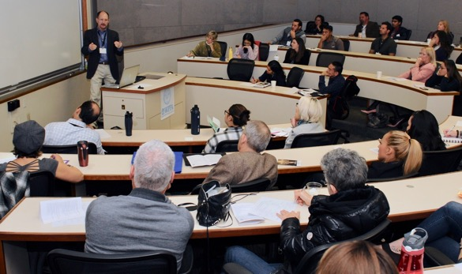
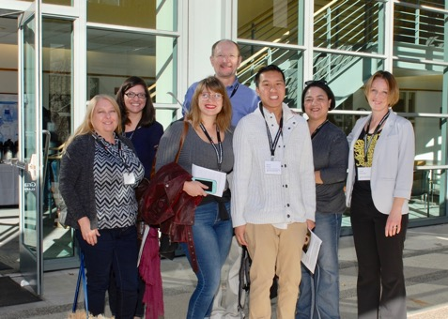

Slide 14
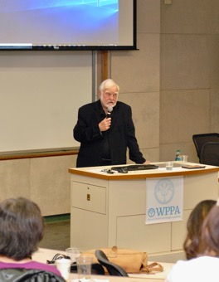
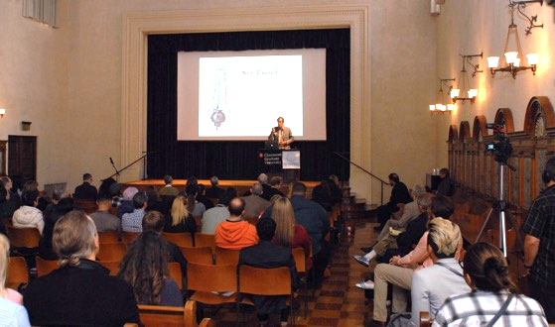
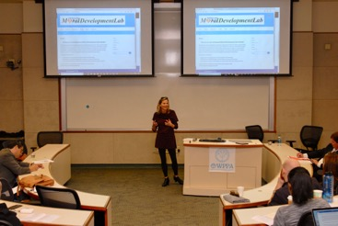
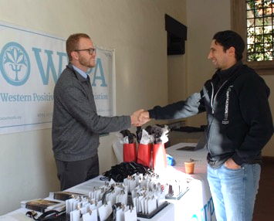
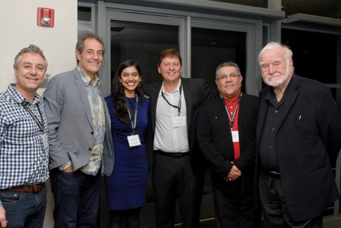
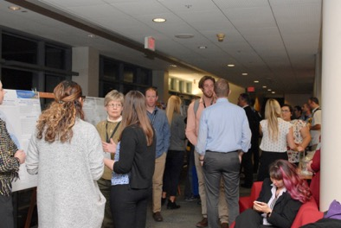

Slide 15
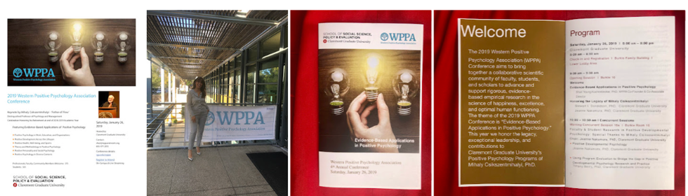
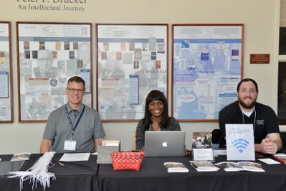
WPPA 4th Conference - CGU 2019

Slide 16

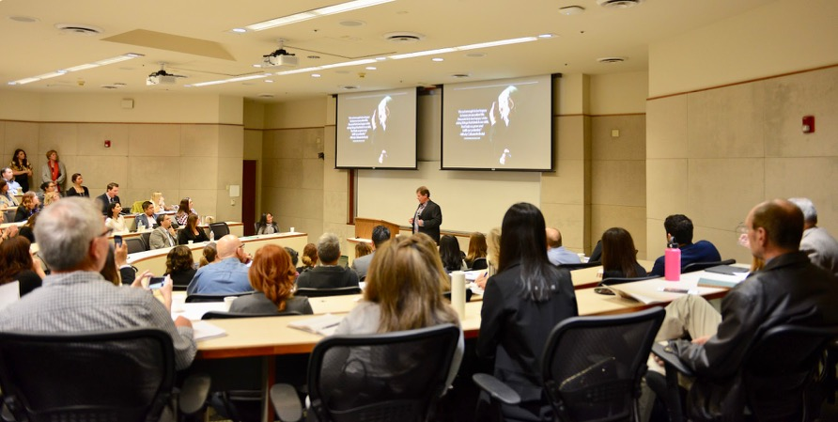

Slide 17
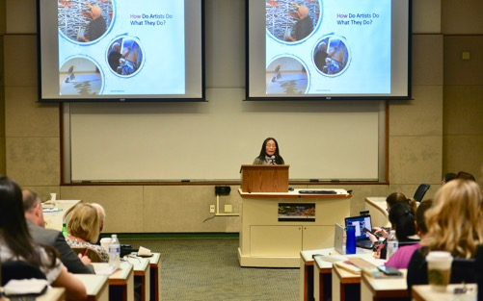
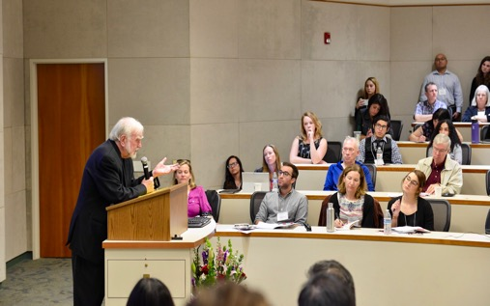
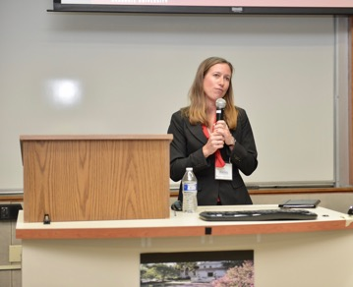



Slide 18






Slide 19

WPPA 2019

Slide 20



WPPA 5th Conference - CGU 2020

Slide 21




Slide 22







Slide 23





Slide 24

WPPA 2020

Slide 25

And then came COVID

Slide 26

WPPA
2021 to 2023

Slide 27


Keynote:
January 2021
Lea Waters
Lea Waters

Slide 28


Keynote:
March 2021
Barb Fredrickson

Slide 29



Slide 30

1st Community of Practice (CoP) - Zoom
April 21, 2021

Slide 31

Keynote: Kim Cameron, October 2021

Slide 32



Slide 33


April, 2022
Fred
Luthans

Slide 34


2nd Community of Practice (CoP) - Zoom
June 2, 2022

Slide 35


3rd CoP Zoom
October, 2022

Slide 36



4th CoP Zoom
December, 2022
Phil Zimbardo

Slide 37


5th CoP Zoom
January
2023

Slide 38

6th CoP Practice Zoom
March
2023

Slide 39


WPPA 8th Conference – University of New Mexico 2024

Slide 40


WPPA 8th Conference – University of New Mexico 2024
From Surviving to Thriving
Professor Bruce Smith
Academic Faculty Conference Chair
Matthew Higgins
Conference Chair

Slide 41







Slide 42








Slide 43




Keynote: Sonja Lubomirsky

Slide 44

WPPA 2024

Slide 45

WPPA 9th Conference
California State University Sacramento (CSUS) 2025

Slide 46



Meliksah Demir
Academic Faculty Conference Chair
Associate Professor of Psychology – CSUS
Rekhi Singh Endowed Professor in Happiness

Slide 47





Slide 48






Slide 49






Slide 50









Slide 51

WPPA 2025

Slide 52

Perma + 4 - Foundations of Well Being
Seligman & Donaldson
Helping others builds our well-being most
  Sonja Lyubomirsky (2024)
8 + Ways to Hope
  Bill Miller (2024)
Gratitude WORKS
  Bob Emmons (2025)
Connection – How to Love and Feel Loved
  Sonja Lyubomirsky (2026)

Slide 53




WPPA 2026
Tatiana Shemiakina
WPPA 10th Conference Chair
10th Anniversary Conference
Hosted by
Claremont Graduate University (CGU)

Slide 54

WPPA 2026

Slide 55
The best is yet to come …

Slide 56
Collective Efficacy – Albert Bandura
Thank you all for joining us.

Slide 57
© Shari Young Kuchenbecker, Ph.D.
Executive Director & Co-Founder
Western Positive Psychology Association (WPPA)
http://www.wppanetwork.org
WPPA.Conference@CGU.edu
shari@wppanetwork.org
https://namedrop.io/shariyoungkuchenbecker
123 E. Eighth Street
Claremont Graduate University
Claremont, CA 91711
Visiting Research Scientist
Haptic Intelligence Department
Max-Planck-Institut für Intelligente Systeme
Max Planck Institute for Intelligent Systems
Heisenbergstraße 3, 70569 Stuttgart, Germany
Phone: 1 + 310 435 8070
Email: slyk@is.mpg.de
shariyo@gmail.com
© June 3, 2026

